Slide 1
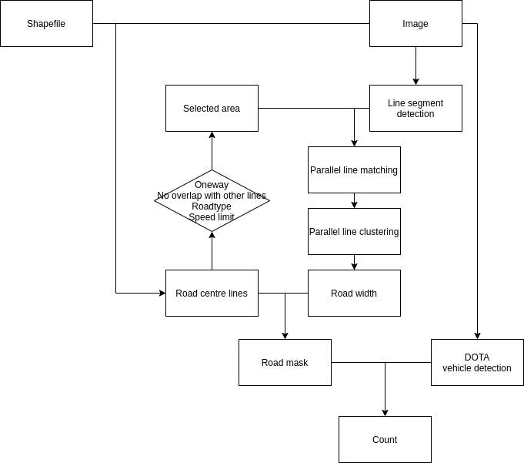
This week, i improved my algorithm, shown in red boxes, to detect road width and build road mask,
And i also aggregate codes, detect and count vehicles in the image for each lines.
Vehicle counting algorithm

Slide 2
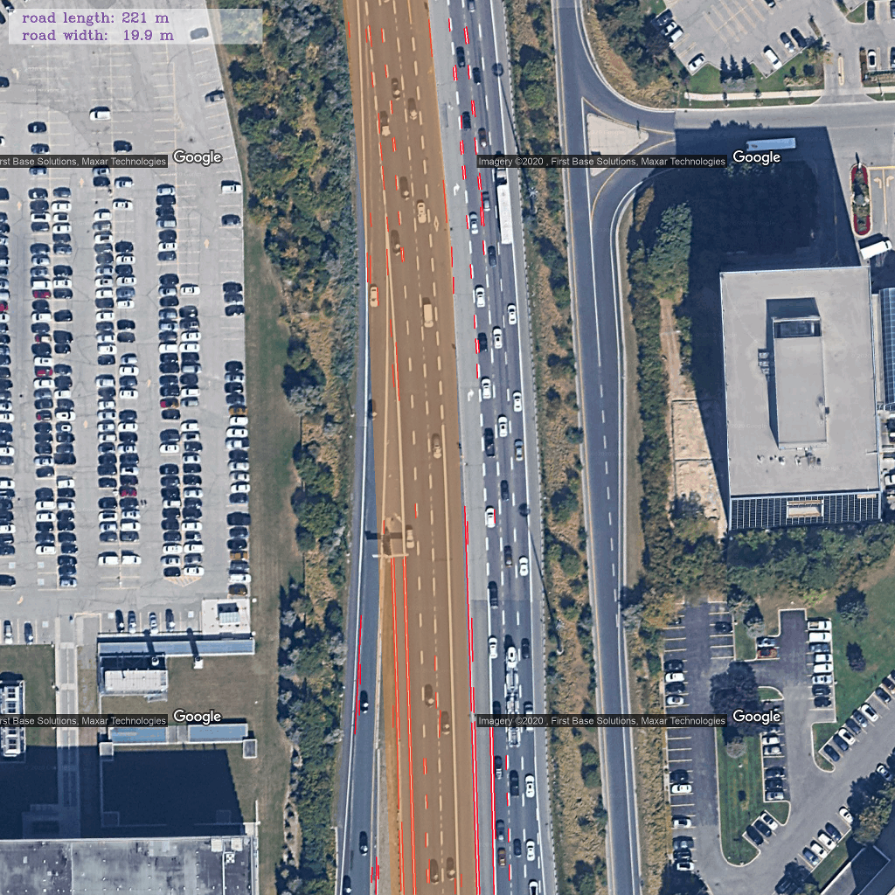
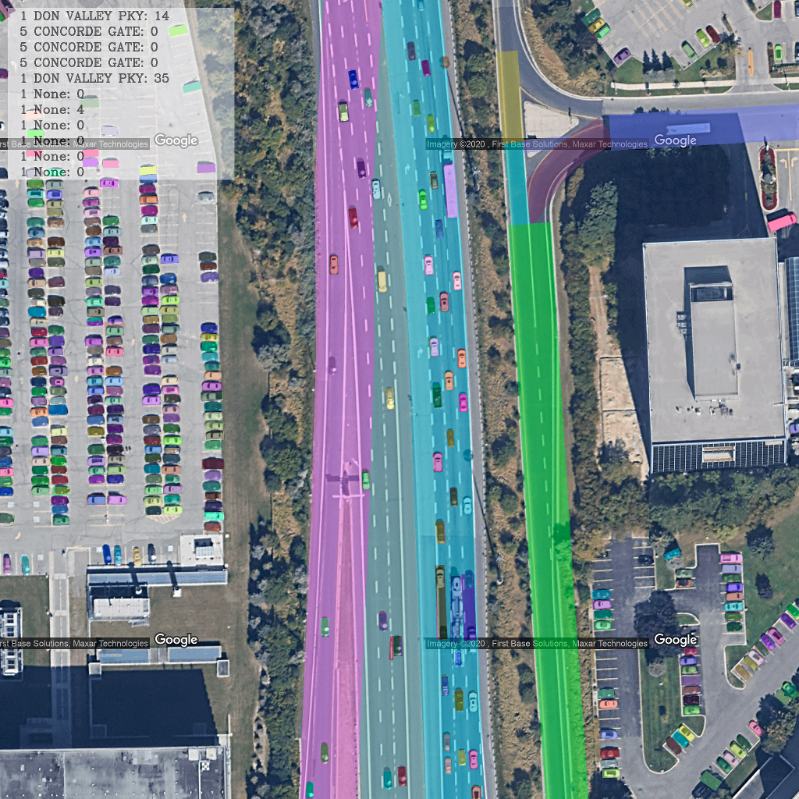
Last week, i extracted the nearest line to the permanent station, and estimated the road width. As the left image shows, and the right image is the updated result. The upper left shows the count.

Slide 3
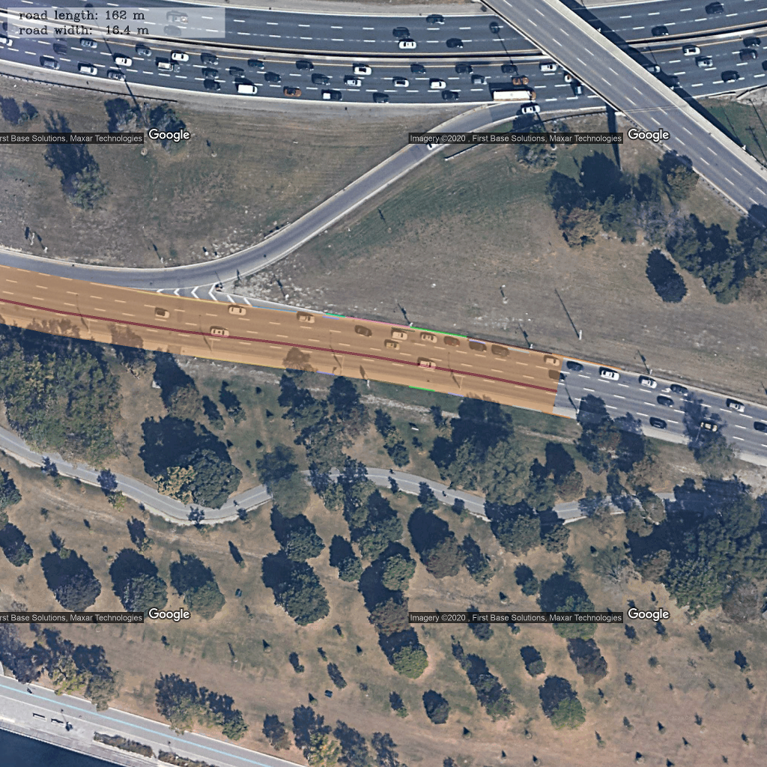
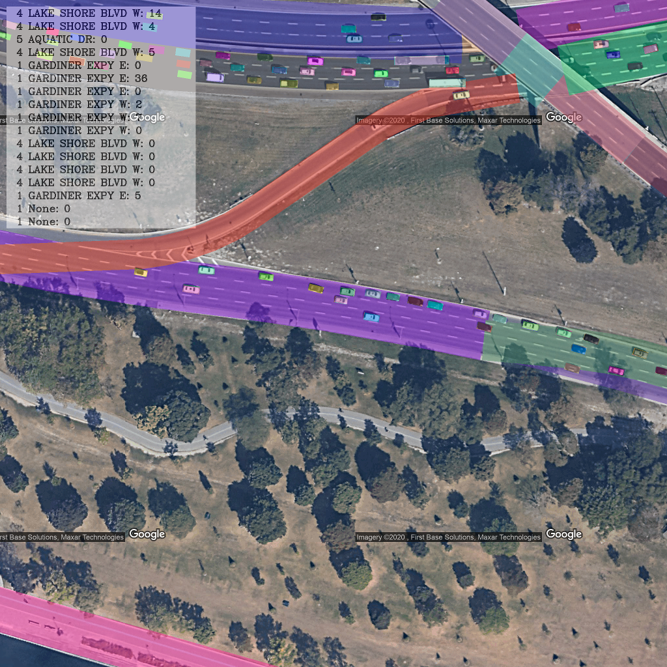

Slide 4
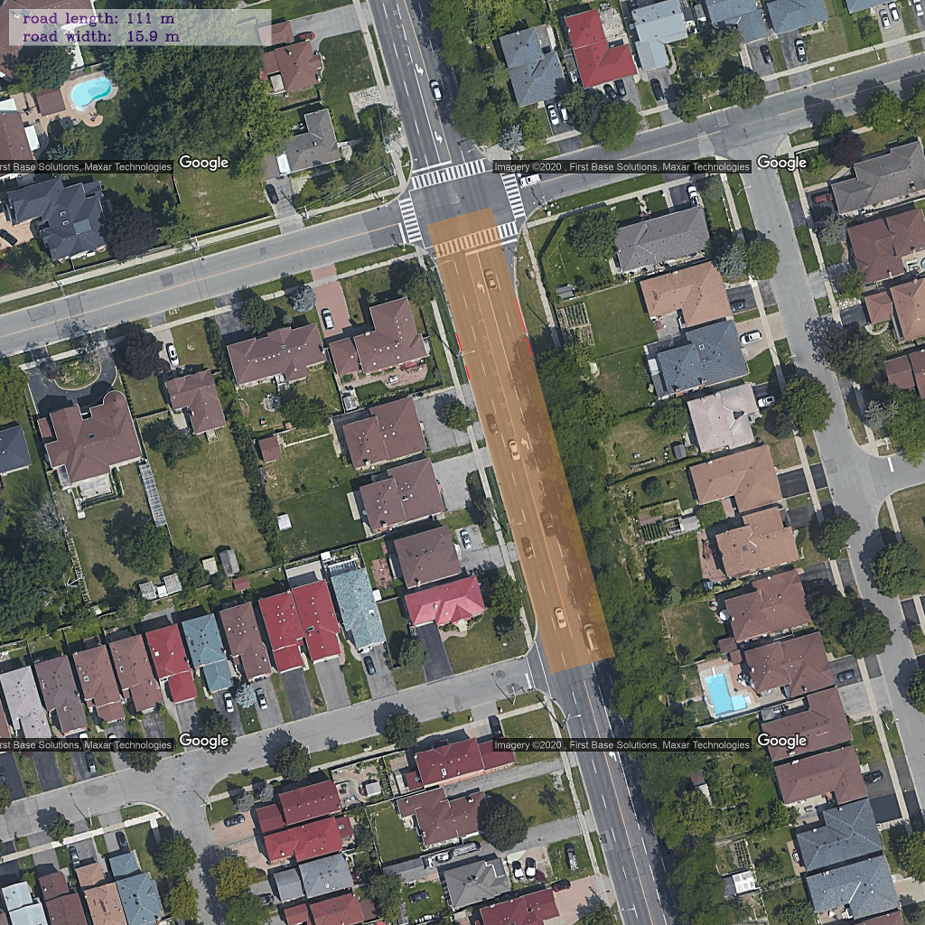
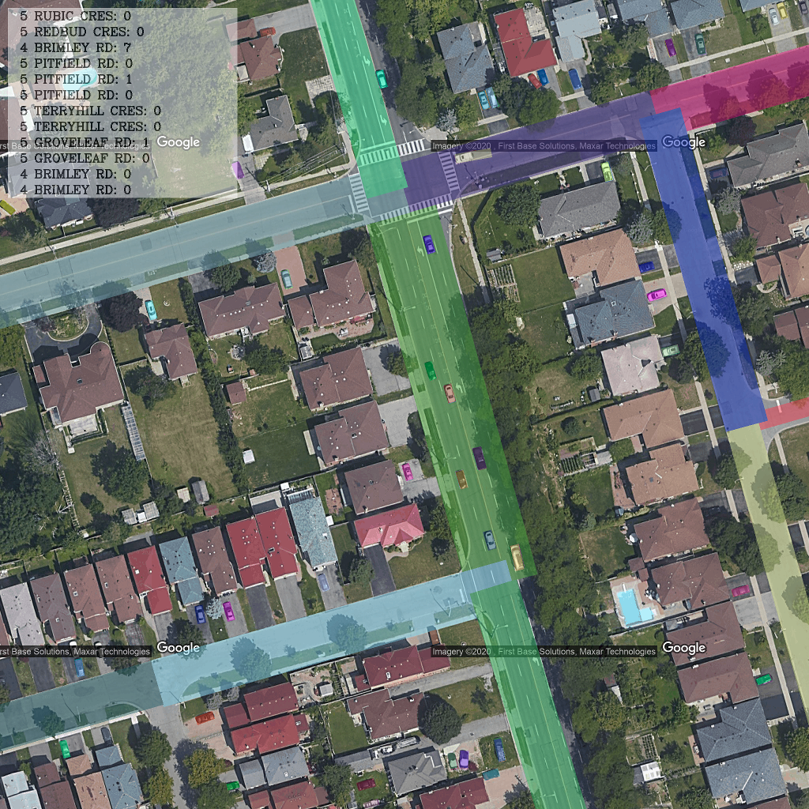

Slide 5
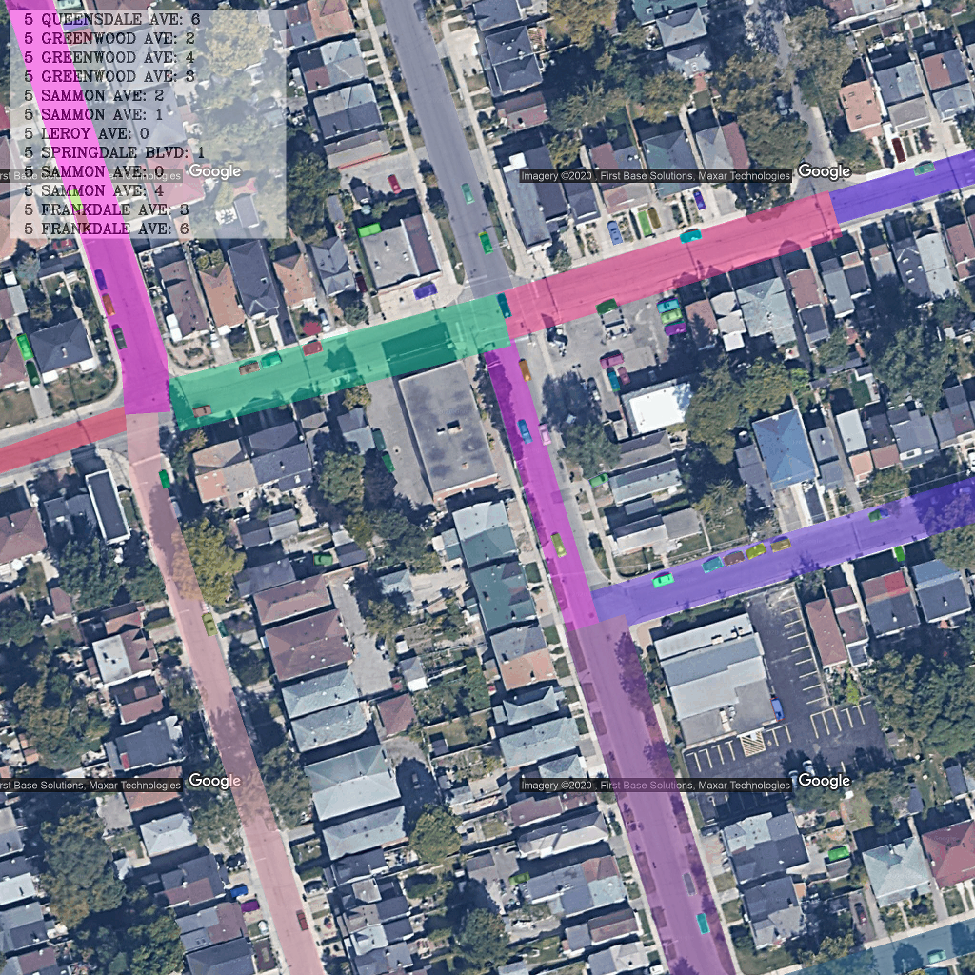
TODO:
1. Remove cars parking on the roadside
2. Summarize the vehicle count and road characteristics according to the same road

